Slide 1

Query Optimisation Through Indexing
Summer Internship Report
Submitted in partial fulfillment of the requirement for the degree of
Bachelor of Technology
in
Electronics and Communications Engineering
By
SANIDHYA PARASHAR
41896302816
Maharaja Surajmal Institute of Technology
(Affiliated to Guru Gobind Singh Indraprastha University)
Janakpuri, New Delhi-58
2016-2020

Slide 2
Objective Behind The Project
This is a research based project, in which we reduce the time taken to search a given record in database, by using B-tree data structure rather than indexing and traditional sequential access.
Therefore, the main objective of this project is to minimise the number of disk access for certain searching of record, and achieving the techniques for arranging the data on a disk so that any piece of data or record, can be located in as few I/O’s as possible.

Slide 3
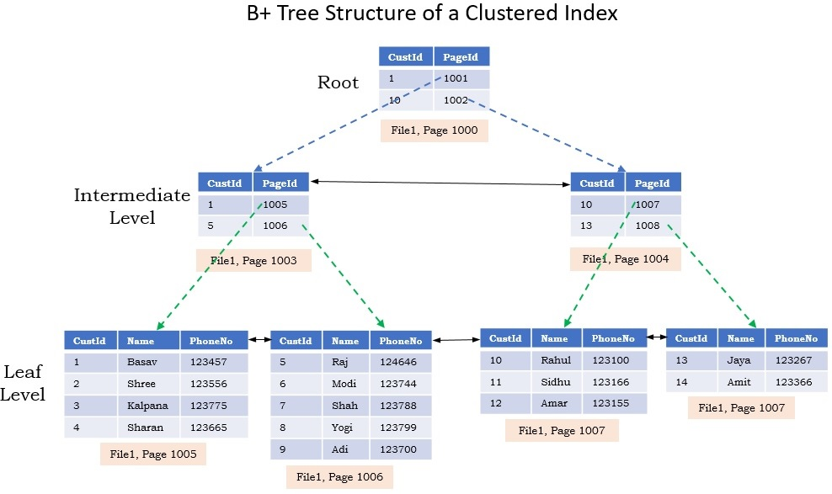
Idea Of Using B+ Tree

Slide 4
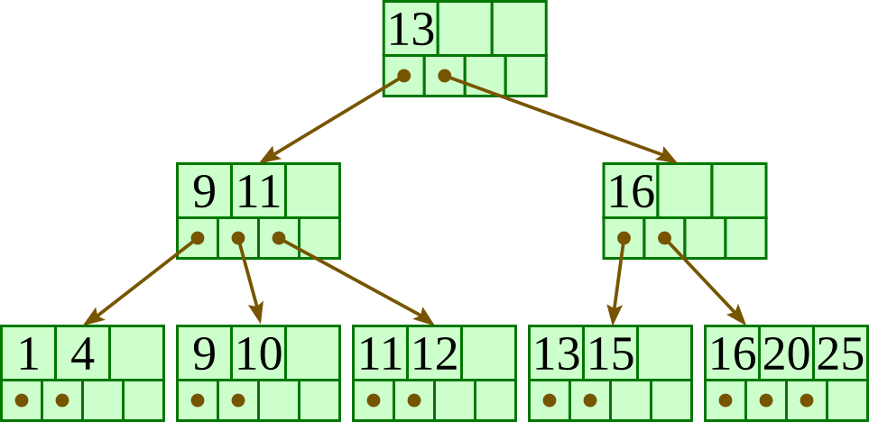
Introduction To B+Tree
A B+ tree is a balanced tree in which every path from the root of the tree to a leaf is of the same length, and each non-leaf node of the tree has between [M/2] and [M] children, where n is fixed for a particular tree.

Slide 5
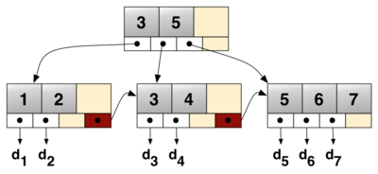
Why should we be using B+ Tree?
It is a variation of B trees in which:
internal nodes contain only search keys (no data)
Leaf nodes contain pointers to data records
Data records are in sorted order by the search key
All leaves are at the same depth.
The various operations of B+ trees will be Explained as:

Slide 6
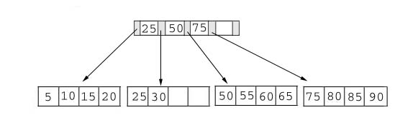
Searching:
Just compare the key value with the data in the tree, then return the result.
And complexity of searching would be O(height).
For example: find the value 45, and 15 in below tree.

Slide 7
Insertion:
inserting a value into a B+ tree may unbalance the tree, so rearrange the tree if needed.
Example : insert 28 into the below tree.
25 28 30
Fits inside the leaf

Slide 8
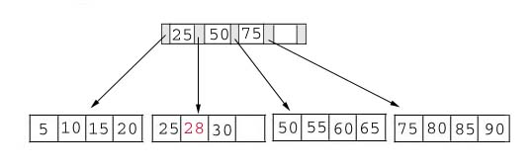

Insertion:
Process: split the leaf and propagate middle key up the tree
50 55 60 65 70
Does not fit inside the leaf
50 55
60 65 70

Slide 9
Working Of Project:

Slide 10
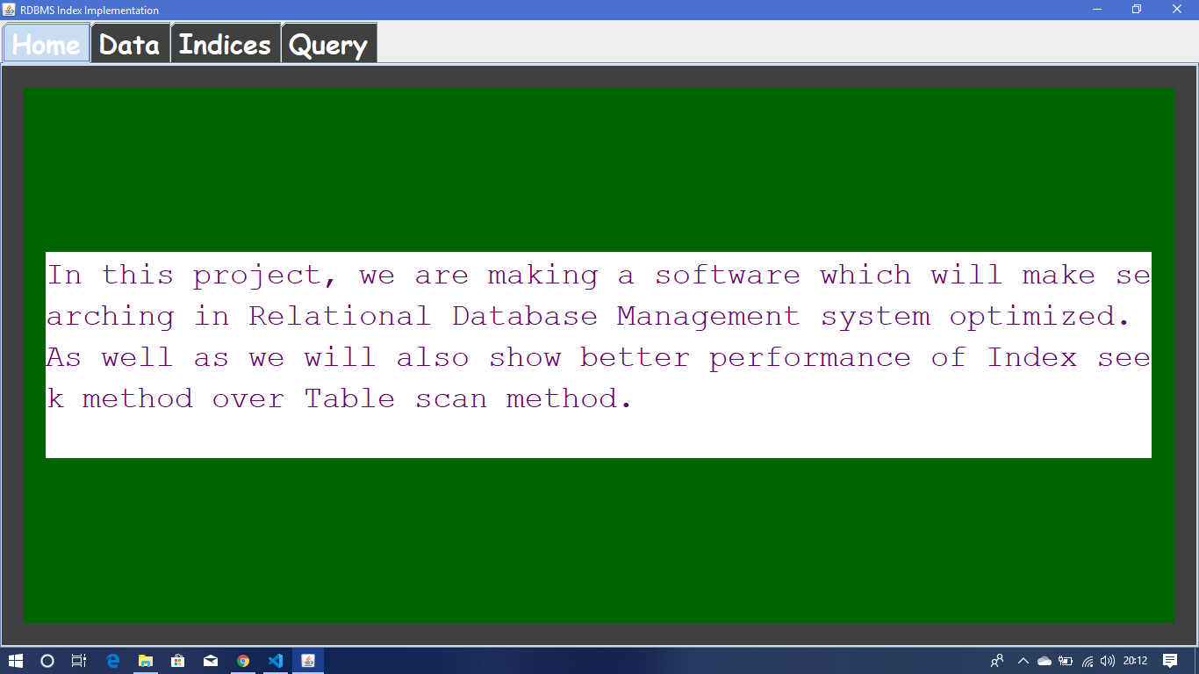
Home Page:
This page is an introduction for the project, and starting of an interface.
With this interface we can check the optimized searching performance of the Index Seek method over the traditional Table Scan method.

Slide 11
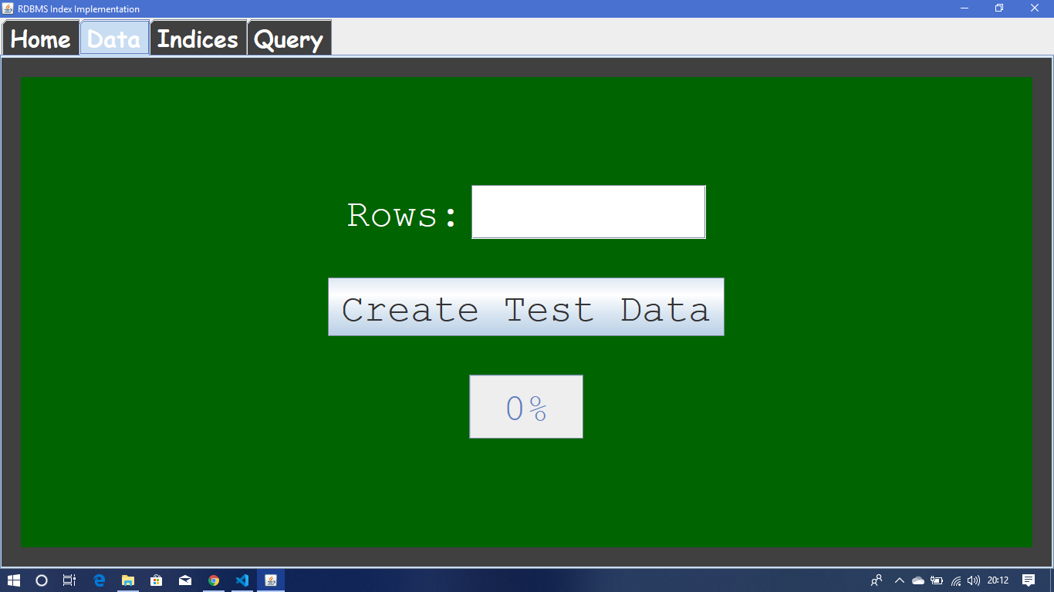
Data Panel Page:
This is Data Panel page, this page helps in creation of random row data in our computer machine.
This data will act as test data for implementing our project, of index seek method for searching of data records in database, in minimum I/O’s operations.

Slide 12
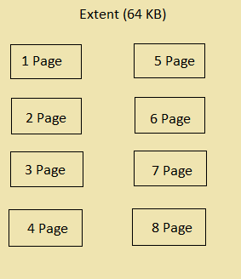
Data Storage Format In Database:
The test data that, we form is stored in the form of data rows inside the pages, then these pages are grouped into extents, and all these extents are stored in the database.
Database>Extents>Pages>Rows

Slide 13
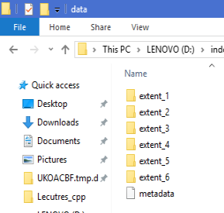
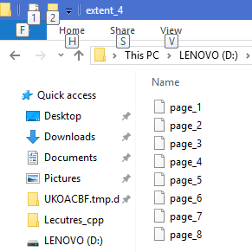
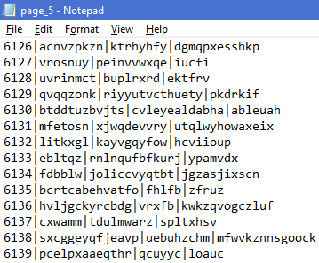
Glimpse of the Data Pages Formed:
Pages Stored Inside any Extent
Data Stored Inside any Page
Extents Inside the Database

Slide 14
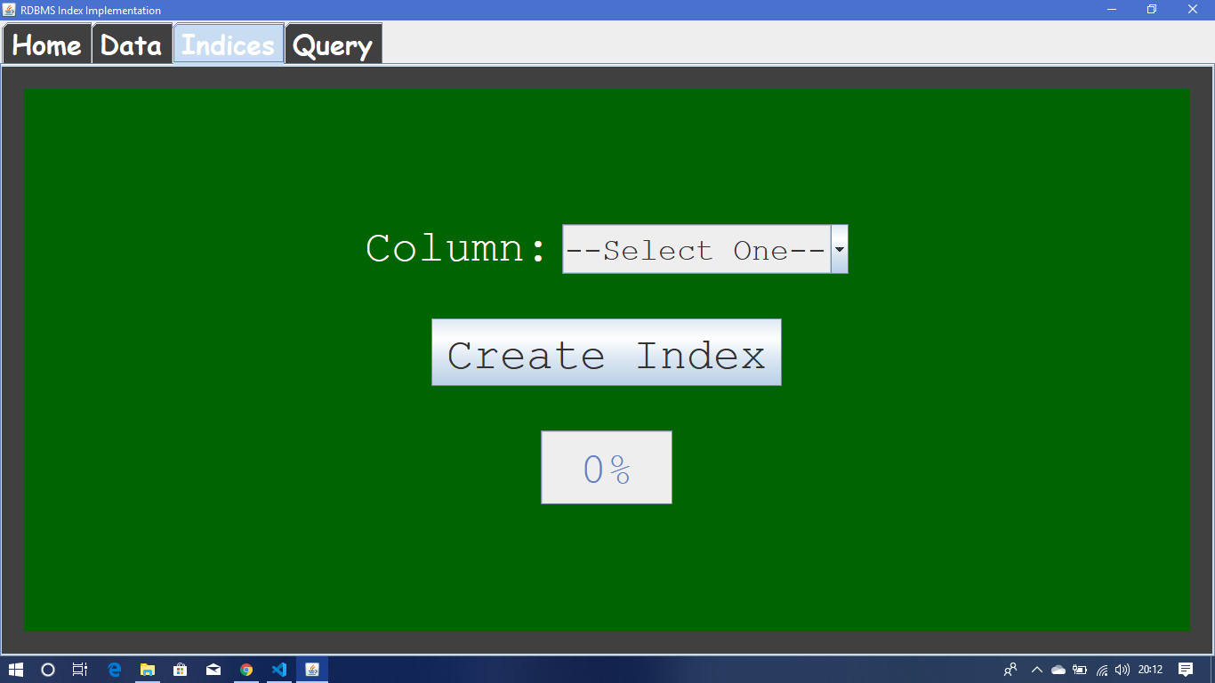
Index Panel Page:
This is Index Panel page, this page let us decide on which column of the database to be used for the index creation.
These indices will be later used for searching process as keys, for applying Index Seek method on database. This method could only be used with those columns on which indices were created.

Slide 15
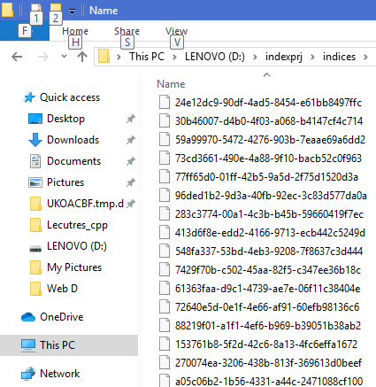
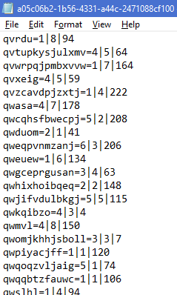
Glimpse of Index Pages Formed:
Data inside Data Pages
Index pages

Slide 16
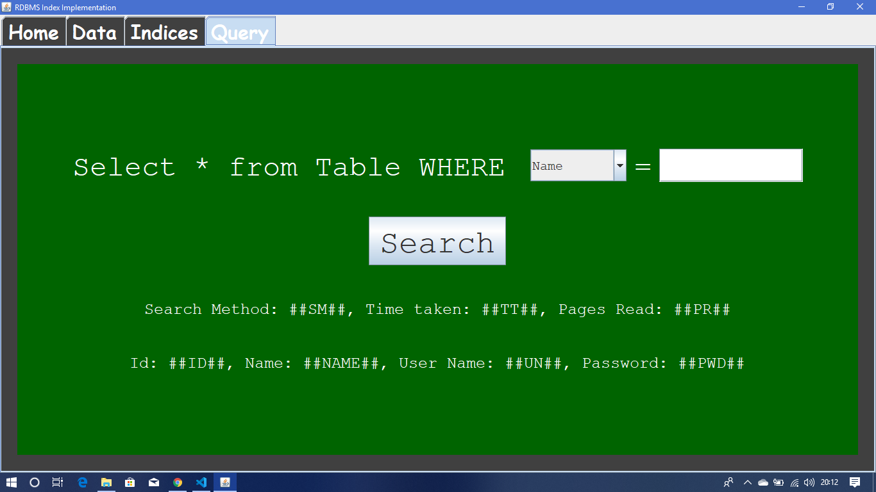
Query Panel Page:
This is Query Panel Page, it will help us to initiate a database search query, for our test database, and we can even select the key, for searching process.
Here, we can see the details like, which method is used for searching, how much time is taken, how many pages are traversed etc.

Slide 17
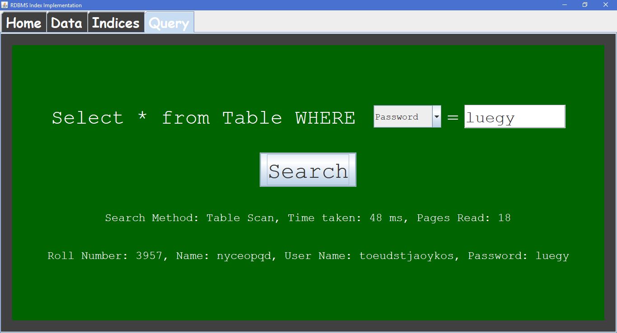
Searching Result With Table Scan Method:

Slide 18

Searching Result With Index Seek Method:

Slide 19
Conclusion:
The use of B+ Tree in the database searching algorithms, will reduce the I/O’s operations for lookups in the database.
Althrought, making of indices for particular column takes up some memory of database, (as we use non-clustered indexing), but this will reduce the searching time for records.
Instead of using Table Scan Method for searching in database we should be using Index Seek Method.

Slide 20
THANK YOU

